Slide 1


Slide 2
An Act to regulate the employment of contract labour in certain establishments
It extends to the whole of India
A workman shall be deemed to be employment as “Contract Labour” when he is hired in or in connection with such work by or through contractor, with or without the knowledge of principal employer

Slide 3
IT Applies (Section 1)
To every establishments in which 20 or more workmen are employed or were employed on any day of the preceding 12 months as contract labour;
To every contractor who employees or who employed on any day of the preceding 12 months 20 0r more workmen

Slide 4
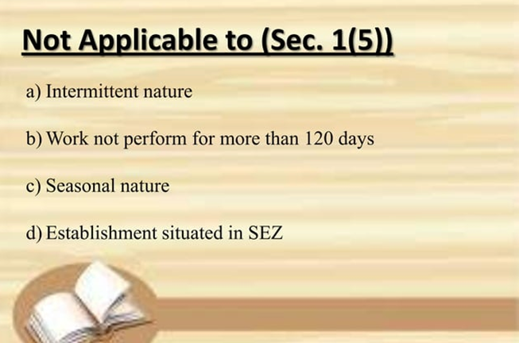

Slide 5


Slide 6


Slide 7


Slide 8
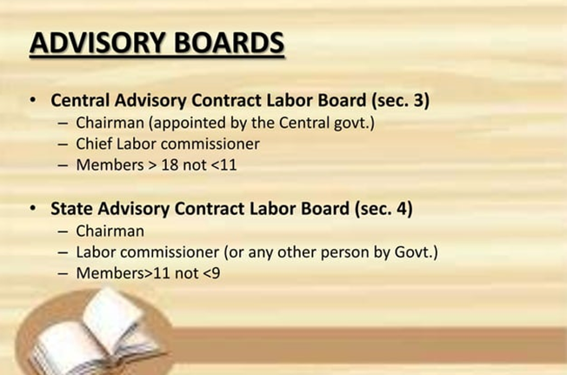

Slide 9
REGISTRATION OF ESTABLISHMENTS EMPLOYING CONTRACT LABOURE Appointment of registering officres (sec 6)
The appropriate Government
Appoint such persons, being Gazetted Officers of Government, to be registering officers, and
Define the limits, within which a registering officer shall exercise the powers conferred on him or under this act.

Slide 10
Registration of certain establishments (sec 7)
By every principal employer within specified time appropriate Government
If the application for registration is complete in all respects, the registering officer shall register the establishment and issue to the principal employer of the establishment a certificate of registration.

Slide 11
LICENSING OF CONTRACTORS Appointment of licensing officers (Sec 11)
The appropriate Government
Appoint such prersons, being Gazatted Officers of Government, to be licensing officers and
Define the limits, within which a licensing officer shall exercise the powers conferred on licensing officers by or under this Act.
Grant License for first and renew (if applied) after investigation as prescribed format, fee,

Slide 12
WELFARE AND HEALTH OF CONTRACT LABOUR
Canteen (Sec 16)
Wherein contract labour numbering one hundred or more is ordinarily employed by a contractor, one or more canteens shall be provided and maintained by the contractor for the use of such contract labour.
Rest –rooms (sec 17)
In every place wherin contract labour is required to halt at night in connection with the work of an establishment
There shall be provided and maintained by the contractor for the use of the contract labour
Shall be sufficiently lighted and ventilated and shall be maintained in a clean and comfortable condition.

Slide 13
Other Facilities (Section 18)
It shall be the duty of every contractor employing contract labour in connection with the work of an establishment to provide and maintain-
A sufficient supply of wholesome drinking water for the Contract labour at convenient places;
A sufficient number of latrines and urinals of the prescribed types so situated as to be convenient and accessible to the contract labour in the establishment; and
Washing facilities,

Slide 14
First aid facilities (Section 19)
There shall be provided and maintained by the contractor accessible during all working hours a first -aid box equipped with the prescribed contents at every place where contract labour is employed by him
(section 20) All expenses incurred by the principal employer in providing the amenity may be recovered by the contractor either by deduction from any amount payable to the contractor under any contract or as a debt payable by the contractor

Slide 15
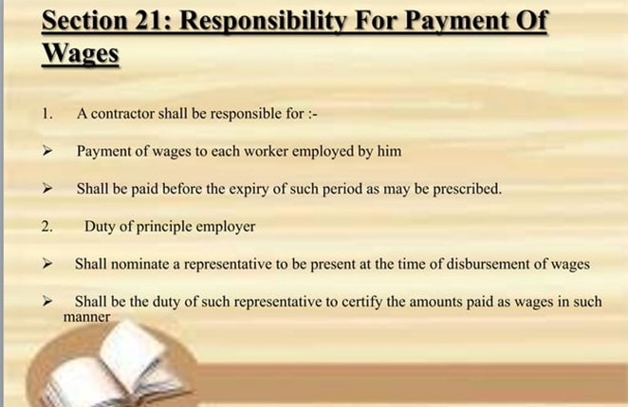

Slide 16


Slide 17
Penalties And Procedure
Obstructions (section 22)
Whoever obstructs an inspector in the discharge of his duties under this Act
Or whoever willfully refuse to produce on the demand of an inspector any register or other document kept in pursuance of this Act
Shall be punishable with imprisonment for a term which may extend to three months, or with fine which may extend to five hundred rupees or with both.

Slide 18
Contravention of provisions regarding employment of contract labour (sec 23)
Whoever contravenes any provision of this Act or any rules made thereunder prohibiting, restricting or regulating the employment of contract labour, or contravenes any condition of license granted under this Act,
Shall be punishable with imprisonment for a term which may extend to three months, or with fine which may extend to one thousand rupees or with both.
And in case of a continuing contravention with an additional fine which may extend to one hundred rupees for every day.

Slide 19
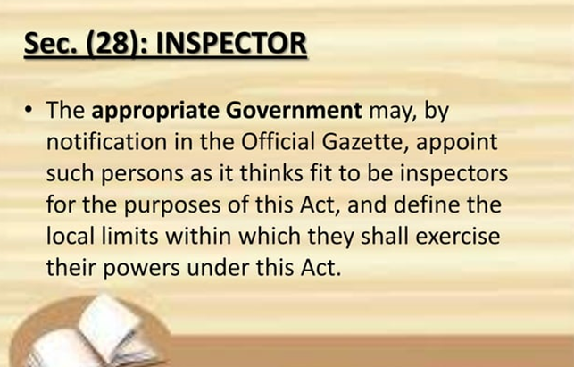

Slide 20
Registers and other records to be maintained.
Every principal employer and every contractor shall maintain such registers and record giving such particulars of
Contract labour employed,
The nature of work performed by the contract labour.

Slide 21
THANK YOU

